Slide 1
MSTL:A Seasonal-Trend Decomposition Algorithm for Time Series with Multiple Seasonal Patterns (2021)
Kasun Bandara, Rob J Hyndman, Christoph Bergmeir
報告者：
經碩二蔡呈昌
經碩二林靜宜

Slide 2
Data source
Country:Victoria, Australia
Data:the half-hourly electricity consumption
Period:149 days starting from 01 January 2012 (3601 hourly observations)

Slide 3
Motivation
help us to understand time series
better forecasting
Multiple Seasonal Patterns
lower computational cost
long-term or short-term planning

Slide 4
Traditional time sereis decomposition method
Seasonal-Trend decomposition using Loess, X-13-ARIMA-SEATS, X-12-ARIMA
Advantage:Robustness and efficiency
Disadvantage:Time series with a single seasonality

Slide 5
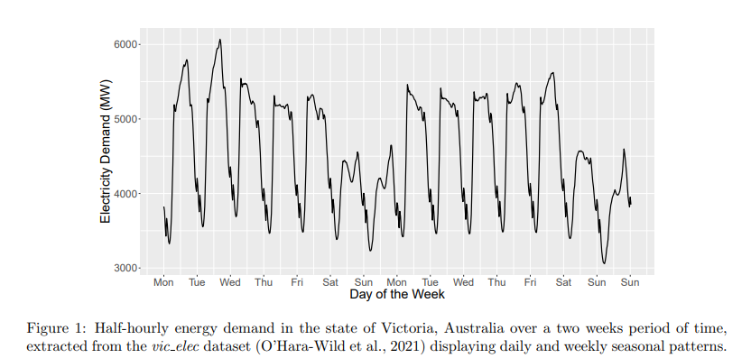
：the average energy consumption in the weekends
：the average energy consumption in the weekdays

Slide 6
STL algorithm
MSTL algorithm
S:seasonal
T:trend
R:remainder
n:the number of seasonal cycles in X

Slide 7
Friedman’s Super Smoother function: for non-seasonal time series
The MSTL algorithm determines the number of distinct seasonal patterns available in the time series.
MSTL arranges the identified seasonal cycles in an ascending order.
If time series is seasonal:
Use MSTL
(in next page)
If time series is non-seasonal:
Original time series (Yt)
= trend (Tt) + remainder (Rt)
subtract trend
remainder

Slide 8
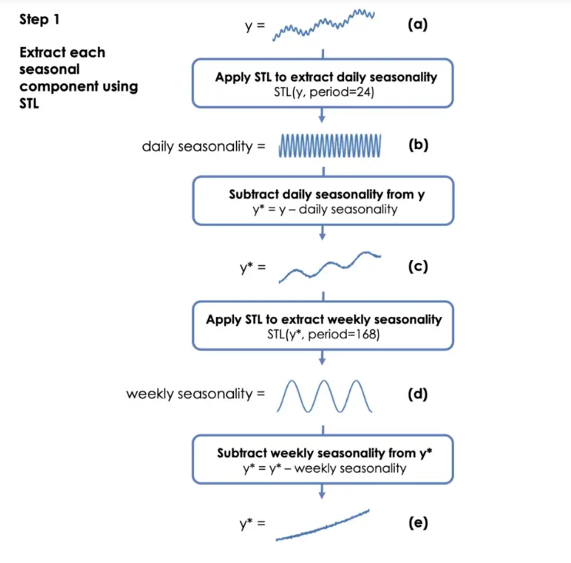
MSTL:STEP 1
Notice:
The frequencies which are smaller than half of the length of the series are ignored.
The missing values of the time series are imputed using the na.interp function.
Box-Cox
yt=Tt+St(weekly)+St(daily)+Rt

Slide 9
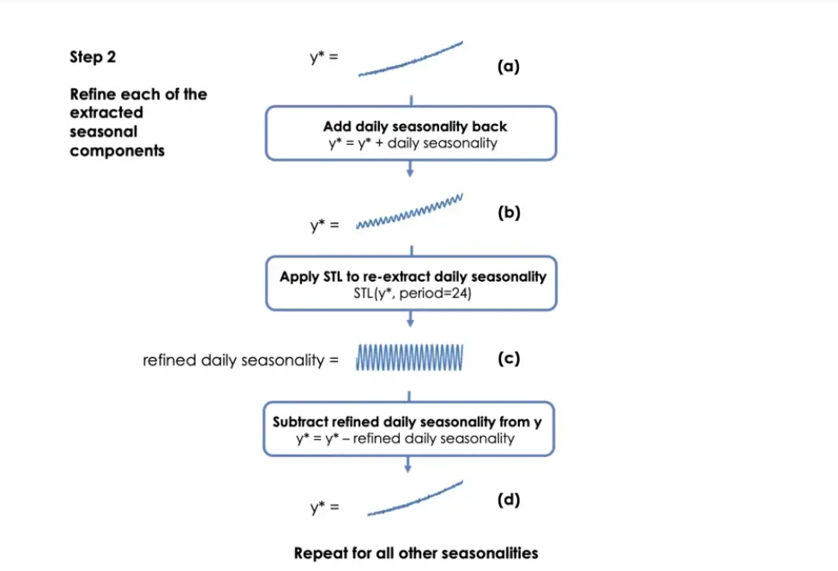
MSTL:STEP 2
The rate of seasonal variation is controlled by the s.window parameter.
a smaller value:the seasonal pattern evolves quickly.
a higher value:the seasonal pattern is constant over time.

Slide 10
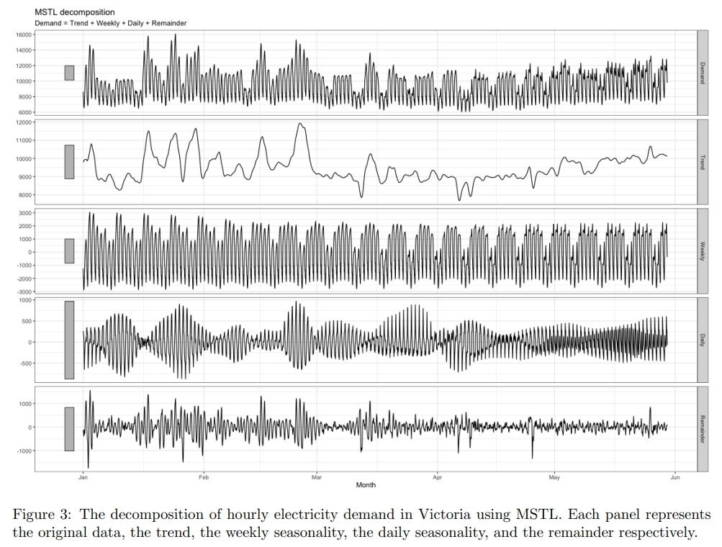
summer
autumn
Electricity Demand
Trend
Weekly
Daily
Remainder
1/1
2/1
3/1
4/1
5/1

Slide 11
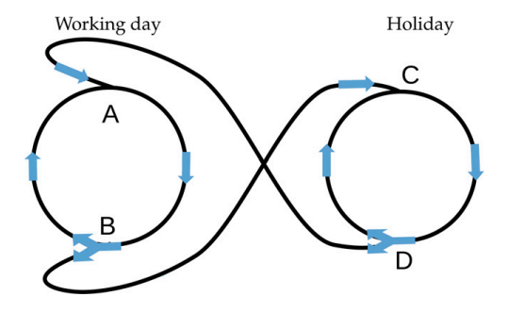
Complex Seasonality

Slide 12
First Method:
MSTL:Multiple Seasonal-Trend decomposition using Loess
Allowing the decomposition of time series with multiple seasonal patterns.
A fast time series decomposition algorithm that is capable of handling time series with multiple seasonal cycles.
S:seasonal
T:trend
R:remainder
n:the number of seasonal cycles in X

Slide 13
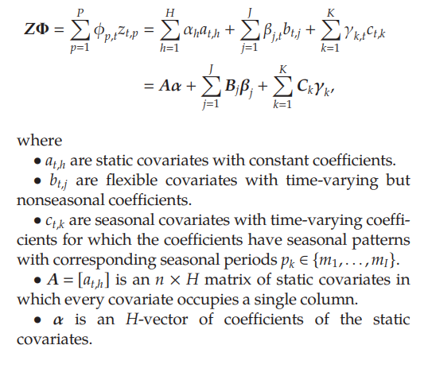

Second Method:
STR:
Seasonal-Trend decomposition
by Regression
Use:Covariation
S:seasonal
T:trend
Z: covariates with coefficients φp,t
R:remainder

Slide 14
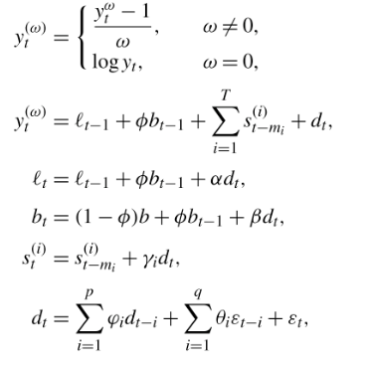
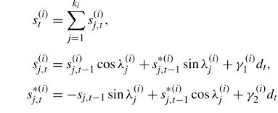
Third Method:
TBATS:Trigonometric Exponential Smoothing
State Space model with Box-Cox transformation,
ARMA errors, Trend and Seasonal Components
Use:autocorrelation
lt:local level in period t
s:seasonal
b:long-run trend;bt:short-run trend in period t
m:the period of T seasonal patterns (i=1,...T)
dt:ARMA(p,q) process
ε:Gaussian white-noise error term with zero mean
ki:the number of seasonal cycles in ki

Slide 15

Fourth Method:
Prophet
Use:holidays
s:seasonal
g:trend
h:holiday
є:remainder

Slide 16
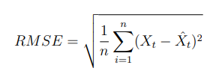
root mean square error (RMSE)

Slide 17
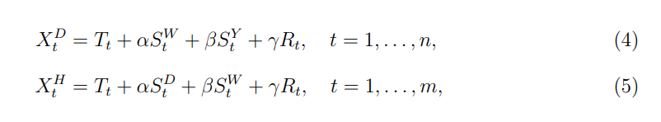
Simulated Data

Slide 18
Simulated Data
Using two data generating processes (DGPs):
The deterministic DGP and the stochastic DGP
The deterministic components are generated by:
The stochastic components are generated by:
time series of daily data:150deterministic DGP + 150 stochastic DGP
time series of hourly data:150deterministic DGP + 150 stochastic DGP

Slide 19
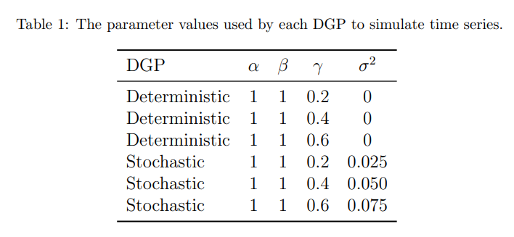
Simulated Data
The lengths of the daily and hourly time series are equivalent to 1096 days and 505 days respectively
(one observation more than three seasonal cycles of the highest available seasonality,
i.e., 365 * 3 + 1 for the daily data and 168 * 3 + 1 for the hourly data).

Slide 20
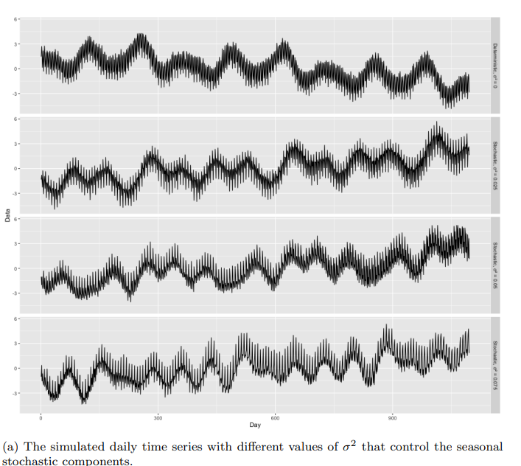
σ^2=0
σ^2=0.025
σ^2=0.050
σ^2=0.075

Slide 21
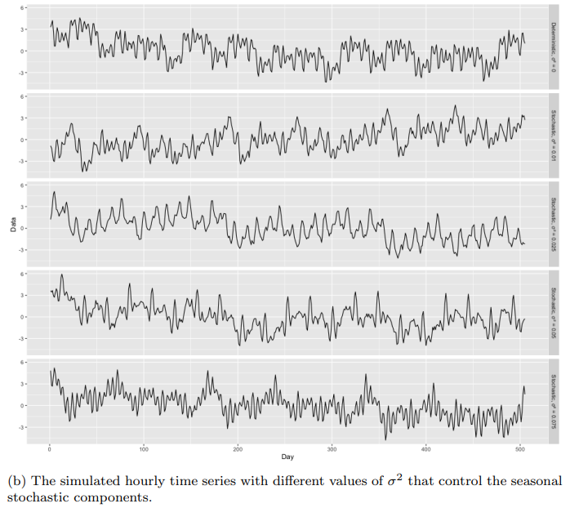
σ^2=0
σ^2=0.01
σ^2=0.025
σ^2=0.050
σ^2=0.075

Slide 22
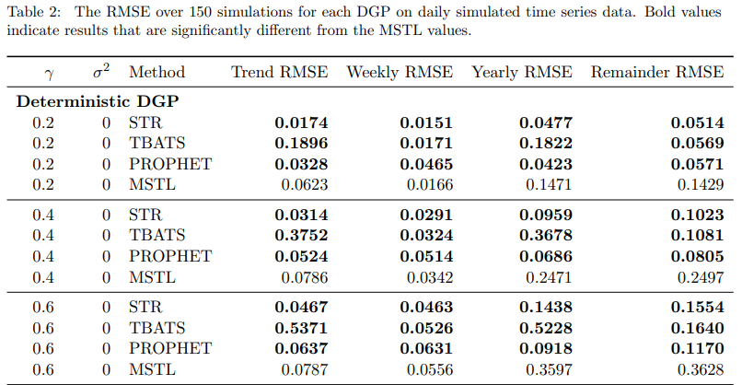
：min. RMSE
：compare with MSTL is worse in the majority of cases

Slide 23
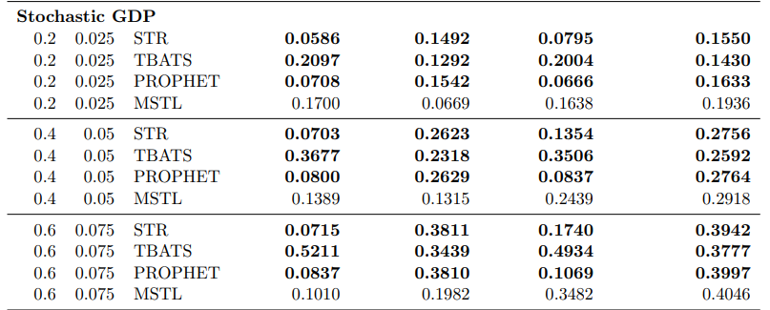
：min. RMSE
：compare with MSTL is worse in the majority of cases

Slide 24
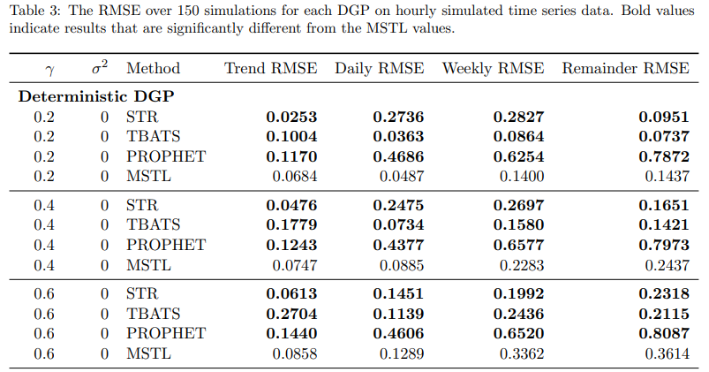
：min. RMSE
：compare with MSTL is worse in the majority of cases

Slide 25
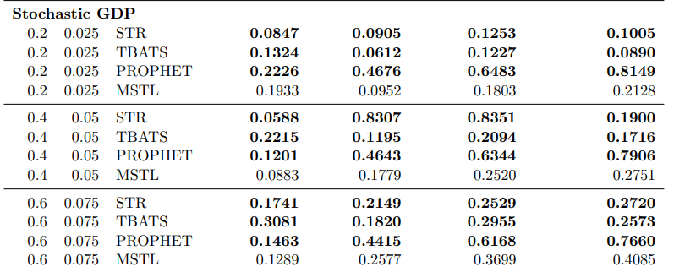
：min. RMSE
：compare with MSTL is worse in the majority of cases

Slide 26
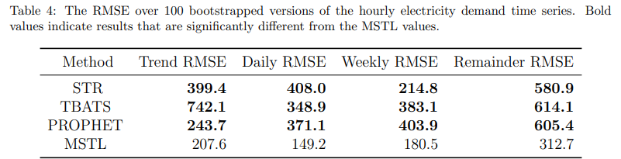
Real data
：min. RMSE

Slide 27
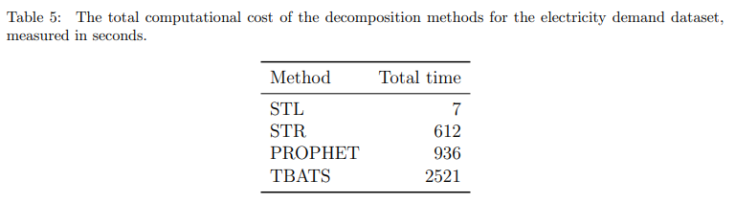
The total computational cost (cost/seconds)

Slide 28
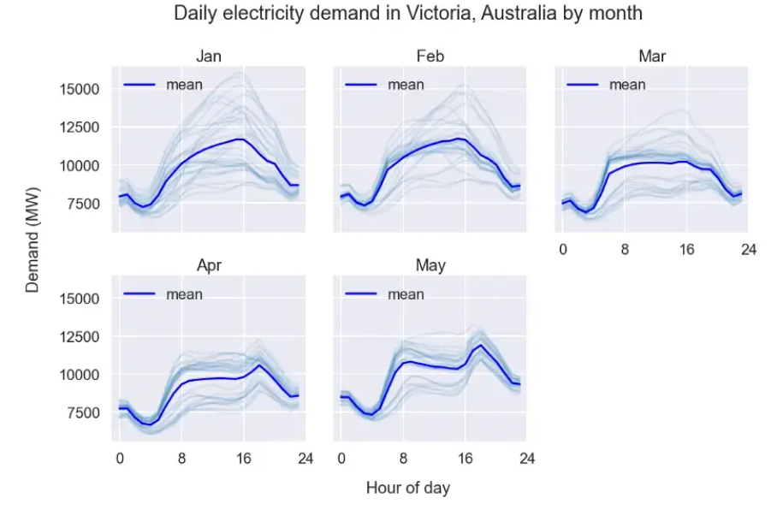

Slide 29
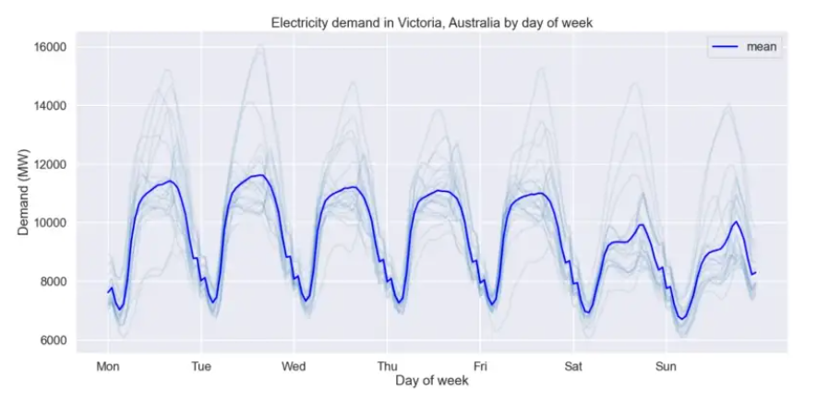

Slide 30
Reference
MSTL
https://towardsdatascience.com/multi-seasonal-time-series-decomposition-using-mstl-in-python-136630e67530
STR
Dokumentov, A. andR. J. Hyndman. 2022. "STR: Seasonal-Trend Decomposition Using Regression" INFORMS Journal on Data Science,1(1), 50-62.
TBATS
https://yintingchou.com/posts/2017-05-03-bats-and-tbats-model/
https://towardsdatascience.com/how-to-forecast-time-series-with-multiple-seasonalities-23c77152347e
Prophet
https://kknews.cc/news/9pjjal8.amp
https://www.sohu.com/a/464430438_176628

Slide 31
Recommendation
Hyndman;, R. J. andY. Khandakar. 2008. "Automatic Time Series Forecasting The forecast" Journal of Statistical Software,27(3).
Dokumentov;, A. andR. J. Hyndman. 2015. "STR:A Seasonal-Trend Decomposition Procedure Based on Regression".
Wen;, Q., J. Gao;, X. Song;, L. Sun;, H. Xu; andS. Zhu. 2019. "RobustSTL: A robust Seasonal-Trend decomposition algorithm for long time series.", 8.

Slide 32
Recommendation
PAKYARDIM, Y. K. 2022. "Modeling Electricty Markets by Integrating".
Dokumentov, A. andR. J. Hyndman. 2022. "STR: Seasonal-Trend Decomposition Using Regression" INFORMS Journal on Data Science,1(1), 50-62.
Mishra;, A., R. Sriharsha; andS. Zhong. 2022. "OnlineSTL Scaling Time Series Decomposition by 100x", 9.

